Slide 1
Inference on SPMs:
Random Field Theory & Alternatives
Thomas Nichols, Ph.D.
Department of Statistics &
Warwick Manufacturing Group
University of Warwick
FIL SPM Course
12 May, 2011

Slide 2
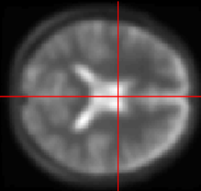
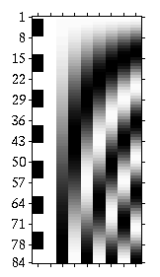
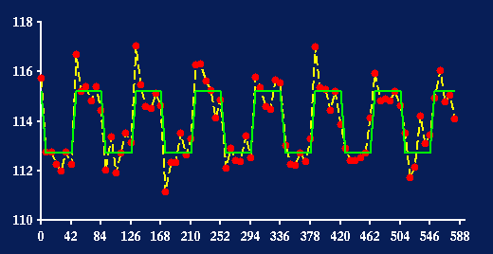
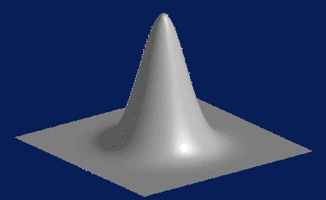
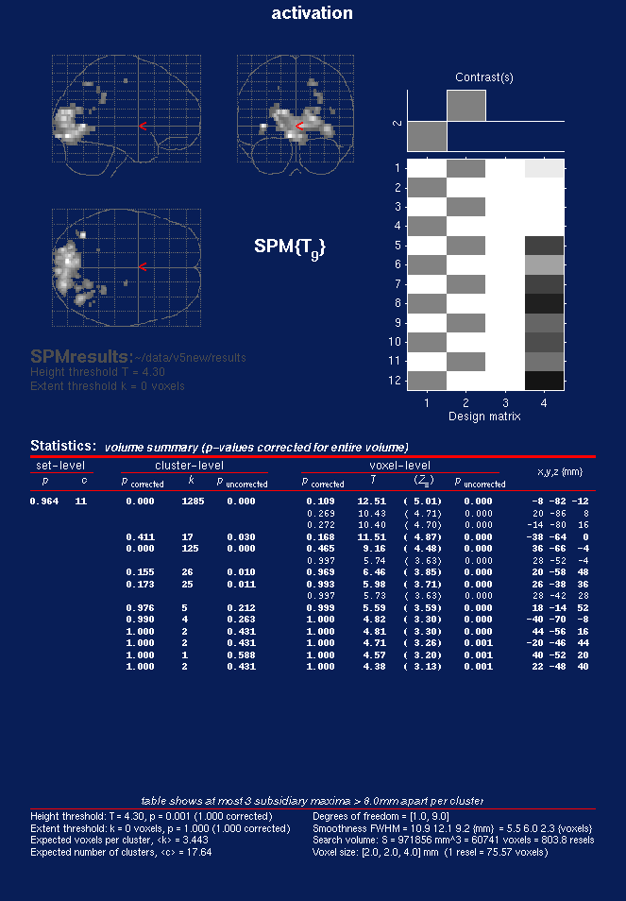
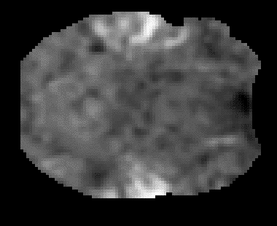
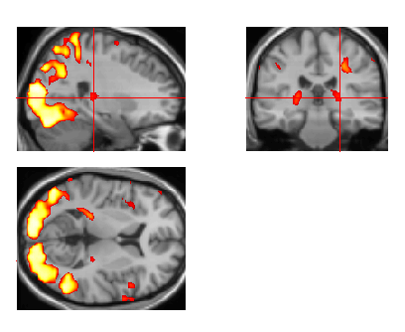
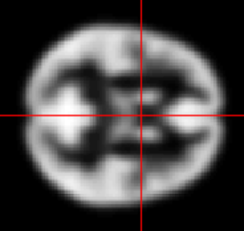
image data
parameter
estimates
design
matrix
kernel
General Linear Model
  model fitting
  statistic image
Thresholding &
Random Field Theory
realignment &
motion
correction
smoothing
normalisation
Statistical
Parametric Map
anatomical
reference
Corrected thresholds & p-values

Slide 3
Assessing Statistic
Images…

Slide 4
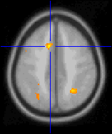
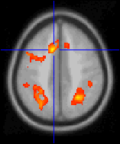
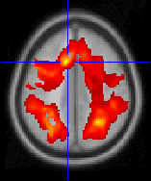
Assessing Statistic Images
Where’s the signal?
High Threshold
Med. Threshold
Low Threshold
t > 5.5
t > 3.5
t > 0.5
Good Specificity
Poor Power
(risk of false negatives)
Poor Specificity
(risk of false positives)
Good Power
  ...but why threshold?!

Slide 5
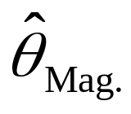
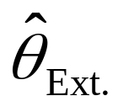
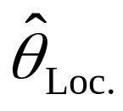
Blue-sky inference:
What we’d like
Don’t threshold, model the signal!
  Signal location?
    Estimates and CI’s on
    (x,y,z) location
  Signal magnitude?
    CI’s on % change
  Spatial extent?
    Estimates and CI’s on activation volume
    Robust to choice of cluster definition
...but this requires an explicit spatial model
space

Slide 6
Blue-sky inference:
What we need
Need an explicit spatial model
No routine spatial modeling methods exist
  High-dimensional mixture modeling problem
  Activations don’t look like Gaussian blobs
  Need realistic shapes, sparse representation
    Some work by Hartvig et al., Penny et al.

Slide 7
Real-life inference:
What we get
Signal location
  Local maximum – no inference
  Center-of-mass – no inference
    Sensitive to blob-defining-threshold
Signal magnitude
  Local maximum intensity – P-values (& CI’s)
Spatial extent
  Cluster volume – P-value, no CI’s
    Sensitive to blob-defining-threshold

Slide 8
Voxel-level Inference
Retain voxels above α-level threshold u_{α}
Gives best spatial specificity
  The null hyp. at a single voxel can be rejected
u_{α}
space
Significant Voxels
No significant Voxels

Slide 9
Cluster-level Inference
Two step-process
  Define clusters by arbitrary threshold u_{clus}
  Retain clusters larger than α-level threshold k_{α}
u_{clus}
space
Cluster not significant
Cluster significant
k_{α}
k_{α}

Slide 10
Cluster-level Inference
Typically better sensitivity
Worse spatial specificity
  The null hyp. of entire cluster is rejected
  Only means that one or more of voxels in cluster active
u_{clus}
space
Cluster not significant
Cluster significant
k_{α}
k_{α}

Slide 11
Set-level Inference
Count number of blobs c
  Minimum blob size k
Worst spatial specificity
  Only can reject global null hypothesis
u_{clus}
space
k
k
Here c = 1; only 1 cluster larger than k

Slide 12
Multiple comparisons…

Slide 13
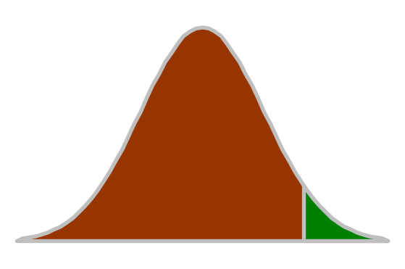
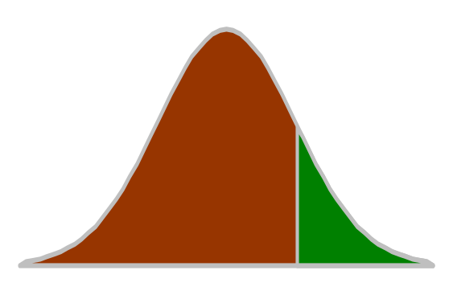
Hypothesis Testing
Null Hypothesis H₀
Test statistic T
  t observed realization of T
α level
  Acceptable false positive rate
  Level α = P( T>u_{α} | H₀ )
  Threshold u_{α} controls false positive rate at level α
P-value
  Assessment of t assuming H₀
  P( T > t | H₀ )
    Prob. of obtaining stat. as large
    or larger in a new experiment
  P(Data|Null) not P(Null|Data)
u_{α}
α
Null Distribution of T
t
P-val
Null Distribution of T

Slide 14
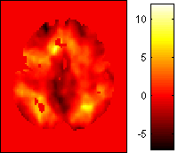
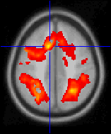
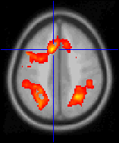
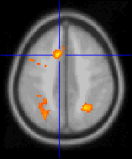
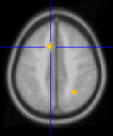
Multiple Comparisons Problem
Which of 100,000 voxels are sig.?
  α=0.05 ⇒ 5,000 false positive voxels
Which of (random number, say) 100 clusters significant?
  α=0.05 ⇒ 5 false positives clusters
t > 0.5
t > 1.5
t > 2.5
t > 3.5
t > 4.5
t > 5.5
t > 6.5

Slide 15
MCP Solutions:
Measuring False Positives
Familywise Error Rate (FWER)
  Familywise Error
    Existence of one or more false positives
  FWER is probability of familywise error
False Discovery Rate (FDR)
  FDR = E(V/R)
  R voxels declared active, V falsely so
    Realized false discovery rate: V/R

Slide 16
MCP Solutions:
Measuring False Positives
Familywise Error Rate (FWER)
  Familywise Error
    Existence of one or more false positives
  FWER is probability of familywise error
False Discovery Rate (FDR)
  FDR = E(V/R)
  R voxels declared active, V falsely so
    Realized false discovery rate: V/R

Slide 17
FWE Multiple comparisons terminology…
Family of hypotheses
  H^{k} k ∈ Ω = {1,…,K}
  H^{Ω} = ∩ H^{k}
Familywise Type I error
  weak control – omnibus test
    Pr(“reject” H^{Ω} ⎪ H^{Ω}) ≤ α
    “anything, anywhere” ?
  strong control – localising test
    Pr(“reject” H^{W} ⎪ H^{W}) ≤ α
      ∀ W: W ⊆ Ω & H^{W}
    “anything, & where” ?
Adjusted p–values
  test level at which reject H^{k}

Slide 18
FWE MCP Solutions:
Bonferroni
For a statistic image T...
  T_{i} i^{th} voxel of statistic image T
...use α = α₀/V
  α₀ FWER level (e.g. 0.05)
  V number of voxels
  u_{α} α-level statistic threshold, P(T_{i} ≥ u_{α}) = α
By Bonferroni inequality...
  FWER = P(FWE)
  = P( ∪_{i} {T_{i} ≥ u_{α}} | H₀)
  ≤ ∑_{i} P( T_{i} ≥ u_{α}| H₀ )
  = ∑_{i} α
  = ∑_{i} α₀ /V = α₀
Conservative under correlation
Independent: V tests
Some dep.: ? tests
Total dep.: 1 test

Slide 19
Random field theory…

Slide 20
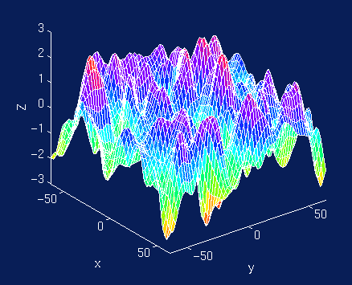
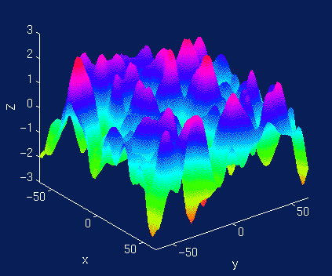
SPM approach:
Random fields…
Consider statistic image as lattice representation of a continuous random field
Use results from continuous random field theory
≈
lattice represtntation

Slide 21
FWER MCP Solutions:
Controlling FWER w/ Max
FWER & distribution of maximum
  FWER = P(FWE)
  = P( ∪_{i} {T_{i} ≥ u} | H_{o})
  = P( max_{i} T_{i} ≥ u | H_{o})
100(1-α)%ile of max dist^{n} controls FWER
  FWER = P( max_{i} T_{i} ≥ u_{α} | H_{o}) = α
  where
    u_{α} = F⁻¹_{max} (1-α)
.
α
u_{α}

Slide 22
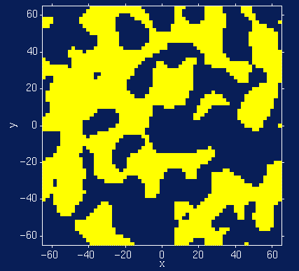
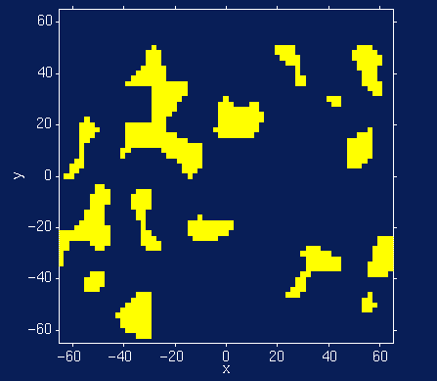
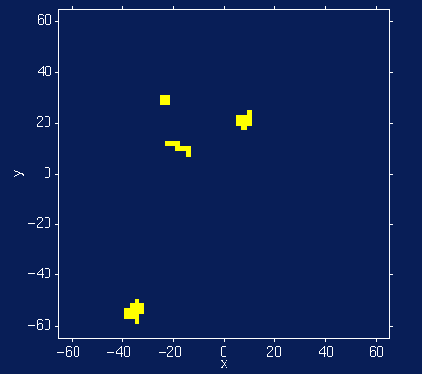
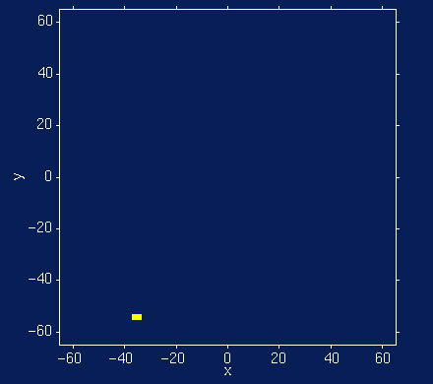
FWER MCP Solutions:
Random Field Theory
Euler Characteristic χ_{u}
  Topological Measure
    #blobs - #holes
  At high thresholds,
  just counts blobs
  FWER = P(Max voxel ≥ u | H_{o})
  = P(One or more blobs | H_{o})
  ≈ P(χ_{u} ≥ 1 | H_{o})
  ≈ E(χ_{u} | H_{o})
Threshold
Random Field
No holes
Never more than 1 blob
Suprathreshold Sets

Slide 23
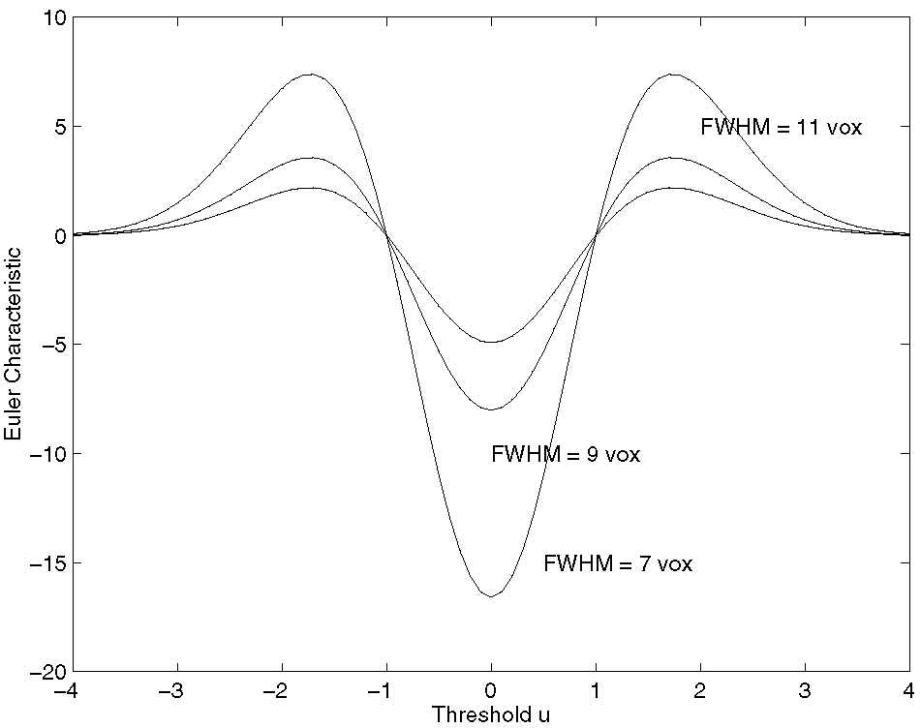
RFT Details:
Expected Euler Characteristic
E(χ_{u}) ≈ λ(Ω) |Λ|^{1/2} (u ² -1) exp(-u ²/2) / (2π)²
  Ω → Search region Ω ⊂ R³
  λ(Ω) → volume
  |Λ|^{1/2} → roughness
Assumptions
  Multivariate Normal
  Stationary*
  ACF twice differentiable at 0
Stationary
  Results valid w/out stationary
  More accurate when stat. holds
Only very upper tail approximates
1-F_{max}(u)

Slide 24
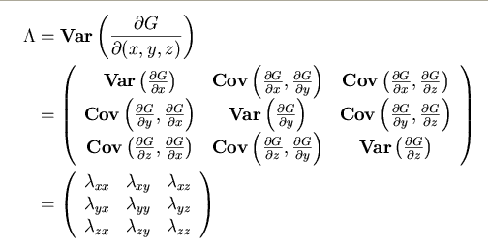
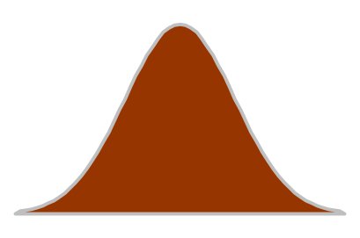
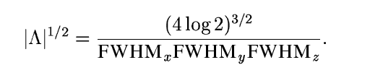
Random Field Theory
Smoothness Parameterization
E(χ_{u}) depends on |Λ|^{1/2}
  Λ roughness matrix:
Smoothness
parameterized as
Full Width at Half Maximum
  FWHM of Gaussian kernel
  needed to smooth a white
  noise random field to
  roughness Λ
FWHM
Autocorrelation Function

Slide 25
Random Field Theory
Smoothness Parameterization
RESELS
  Resolution Elements
  1 RESEL = FWHM_{x} × FWHM_{y} × FWHM_{z}
  RESEL Count R
    R = λ(Ω) √ |Λ| = (4log2)^{3/2} λ(Ω) / ( FWHM_{x} × FWHM_{y} × FWHM_{z} )
    Volume of search region in units of smoothness
    Eg: 10 voxels, 2.5 FWHM 4 RESELS
Beware RESEL misinterpretation
  RESEL are not “number of independent ‘things’ in the image”
    See Nichols & Hayasaka, 2003, Stat. Meth. in Med. Res.
    .
1
2
3
4
5
6
7
8
9
10
1
2
3
4

Slide 26
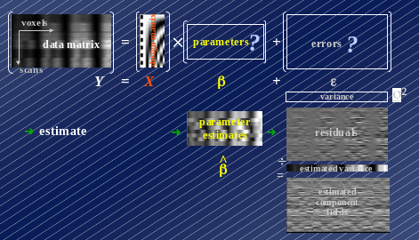
Random Field Theory
Smoothness Estimation
Smoothness est’d
from standardized
residuals
  Variance of
  gradients
  Yields resels per
  voxel (RPV)
RPV image
  Local roughness est.
  Can transform in to local smoothness est.
    FWHM Img = (RPV Img)^{-1/D}
    Dimension D, e.g. D=2 or 3

Slide 27
Random Field Intuition
Corrected P-value for voxel value t
  P^{c} = P(max T > t)
  ≈ E(χ_{t})
  ≈ λ(Ω) |Λ|^{1/2} t² exp(-t²/2)
Statistic value t increases
  P^{c} decreases (but only for large t)
Search volume increases
  P^{c} increases (more severe MCP)
Roughness increases (Smoothness decreases)
  P^{c} increases (more severe MCP)

Slide 28
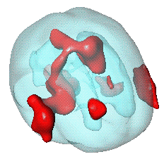
RFT Details:
Unified Formula
General form for expected Euler characteristic
    χ², F, & t fields • restricted search regions • D dimensions •
E[χ_{u}(Ω)] = _{Σd} R_{d} (Ω) ρ_{d} (u)
R_{d} (Ω): d-dimensional Minkowski
functional of Ω
– function of dimension,
space Ω and smoothness:
R₀(Ω) = χ(Ω) Euler characteristic of Ω
R₁(Ω) = resel diameter
R₂(Ω) = resel surface area
R₃(Ω) = resel volume
ρ_{d} (Ω): d-dimensional EC density of Z(x)
– function of dimension and threshold,
specific for RF type:
E.g. Gaussian RF:
ρ₀(u) = 1- Φ(u)
ρ₁(u) = (4 ln2)^{1/2} exp(-u²/2) / (2π)
ρ₂(u) = (4 ln2) exp(-u²/2) / (2π)^{3/2}
ρ₃(u) = (4 ln2)^{3/2} (u² -1) exp(-u²/2) / (2π)²
ρ₄(u) = (4 ln2)² (u³ -3u) exp(-u²/2) / (2π)^{5/2}
Ω

Slide 29
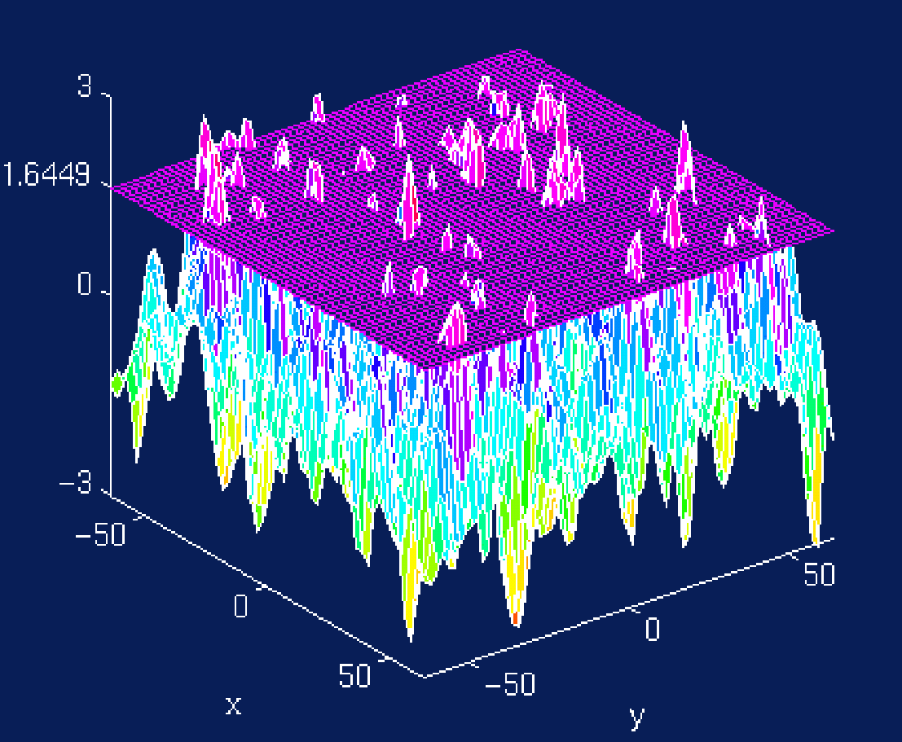
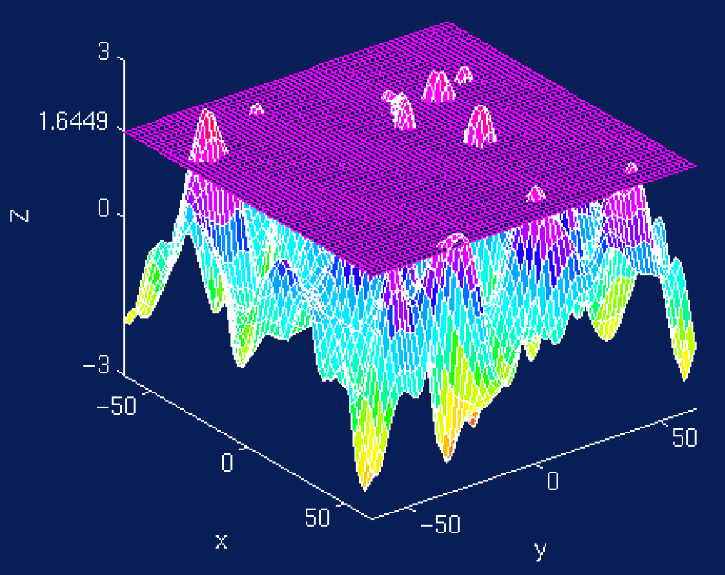
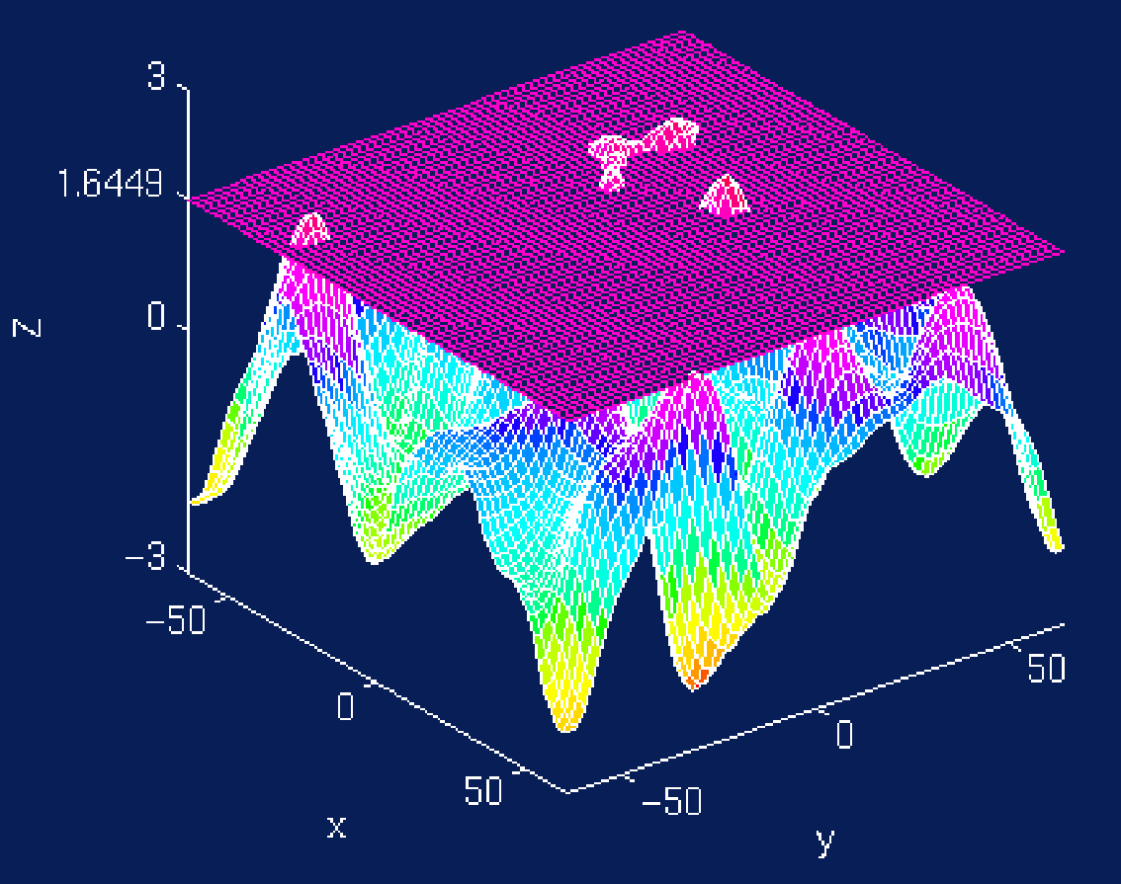
Random Field Theory
Cluster Size Tests
Expected Cluster Size
  E(S) = E(N)/E(L)
  S cluster size
  N suprathreshold volume
  λ({T > u_{clus}})
  L number of clusters
E(N) = λ(Ω) P( T > u_{clus} )
E(L) ≈ E(χ_{u})
  Assuming no holes
5mm FWHM
10mm FWHM
15mm FWHM

Slide 30
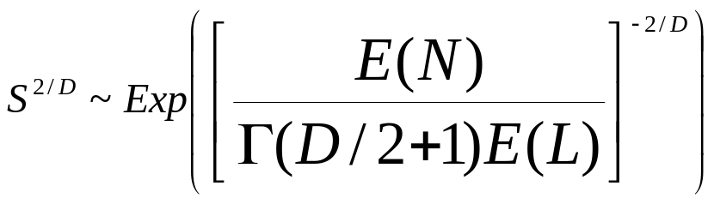
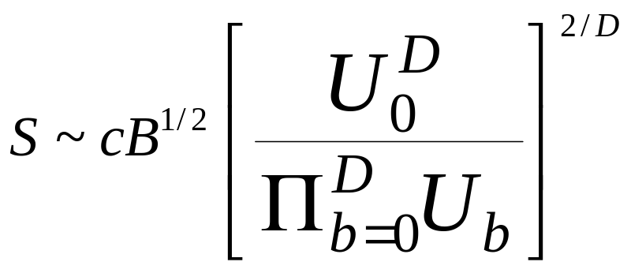
Random Field Theory
Cluster Size Distribution
Gaussian Random Fields (Nosko, 1969)
  D: Dimension of RF
t Random Fields (Cao, 1999)
  B: Beta dist^{n}
  U’s: χ²’s
  c chosen s.t.
  E(S) = E(N) / E(L)

Slide 31
Random Field Theory
Cluster Size Corrected P-Values
Previous results give uncorrected P-value
Corrected P-value
  Bonferroni
    Correct for expected number of clusters
    Corrected P^{c} = E(L) P^{uncorr}
  Poisson Clumping Heuristic (Adler, 1980)
    Corrected P^{c} = 1 - exp( -E(L) P^{uncorr} )

Slide 32
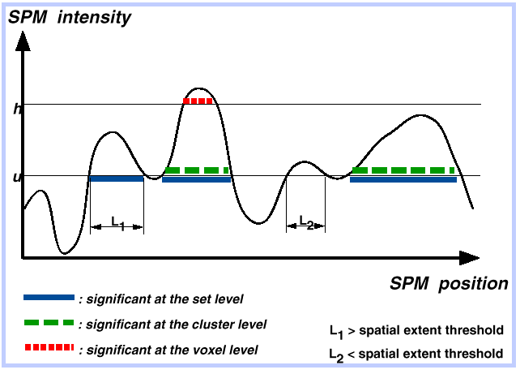
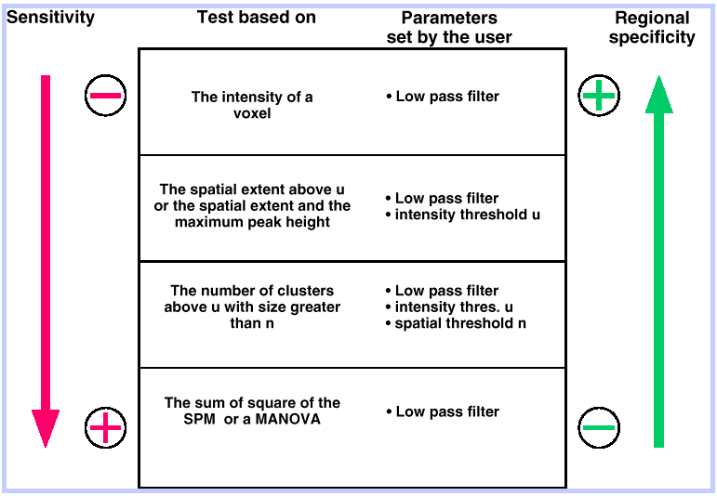

Review:
Levels of inference & power
Set level…
Cluster level…
Voxel level…

Slide 33
Random Field Theory Limitations
Lattice Image
Data
Sufficient smoothness
  FWHM smoothness 3-4× voxel size (Z)
  More like ~10× for low-df T images
Smoothness estimation
  Estimate is biased when images not sufficiently smooth
Multivariate normality
  Virtually impossible to check
Several layers of approximations
Stationary required for cluster size results
≈
Continuous Random Field

Slide 34
Real Data
Active
...
fMRI Study of Working Memory
  12 subjects, block design Marshuetz et al (2000)
  Item Recognition
    Active:View five letters, 2s pause,
    view probe letter, respond
    Baseline: View XXXXX, 2s pause,
    view Y or N, respond
Second Level RFX
  Difference image, A-B constructed
  for each subject
  One sample t test
...
D
UBKDA
yes
Baseline
...
...
N
XXXXX
no

Slide 35
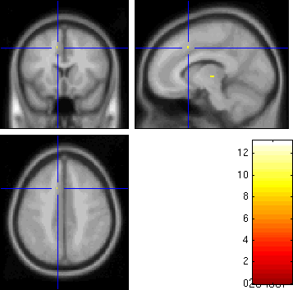
Real Data:
RFT Result
Threshold
  S = 110,776
  2 × 2 × 2 voxels
  5.1 × 5.8 × 6.9 mm
  FWHM
  u = 9.870
Result
  5 voxels above
  the threshold
  0.0063 minimum
  FWE-corrected
  p-value
-log₁₀ p-value

Slide 36
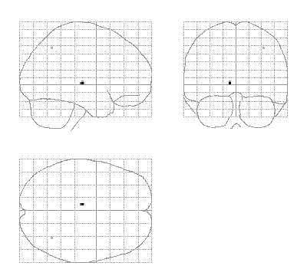
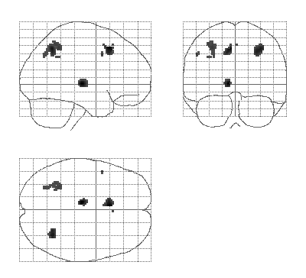
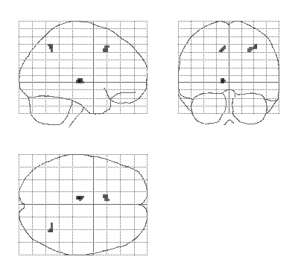
Real Data:
SnPM Promotional
Nonparametric method more powerful than RFT for low DF
“Variance Smoothing” even more sensitive
FWE controlled all the while!
u^{RF} = 9.87
u^{Bonf} = 9.80
5 sig. vox.
t₁₁ Statistic, RF & Bonf. Threshold
u^{Perm} = 7.67
58 sig. vox.
378 sig. vox.
Smoothed Variance t Statistic,
Nonparametric Threshold
t₁₁ Statistic, Nonparametric Threshold

Slide 37
False Discovery Rate…

Slide 38
MCP Solutions:
Measuring False Positives
Familywise Error Rate (FWER)
  Familywise Error
    Existence of one or more false positives
  FWER is probability of familywise error
False Discovery Rate (FDR)
  FDR = E(V/R)
  R voxels declared active, V falsely so
    Realized false discovery rate: V/R

Slide 39
False Discovery Rate
For any threshold, all voxels can be cross-classified:
Realized FDR
rFDR = V_{0R}/(V_{1R}+V_{0R}) = V_{0R}/N_{R}
  If N_{R} = 0, rFDR = 0
But only can observe N_{R}, don’t know V_{1R} & V_{0R}
  We control the expected rFDR
  FDR = E(rFDR)
 | Accept Null | Reject Null
Null True | V_{0A} | V_{0R} | m₀
Null False | V_{1A} | V_{1R} | m₁
 | N_{A} | N_{R} | V

Slide 40






















False Discovery Rate
Illustration:
Noise
Signal
Signal+Noise

Slide 41






























Control of Per Comparison Rate at 10%
11.3%
11.3%
12.5%
10.8%
11.5%
10.0%
10.7%
11.2%
10.2%
9.5%
Percentage of Null Pixels that are False Positives
Control of Familywise Error Rate at 10%
FWE
Occurrence of Familywise Error
Control of False Discovery Rate at 10%
6.7%
10.4%
14.9%
9.3%
16.2%
13.8%
14.0%
10.5%
12.2%
8.7%
Percentage of Activated Pixels that are False Positives

Slide 42
Benjamini & Hochberg
Procedure
Select desired limit q on FDR
Order p-values, p₍₁₎ ≤ p₍₂₎ ≤ ... ≤ p_{(V)}
Let r be largest i such that
Reject all hypotheses
corresponding to
p₍₁₎, ... , p_{(r)}.
JRSS-B (1995)
57:289-300
p_{(i)} ≤ i/V × q
1
p_{(i)}
p-value
i/V × q
0
0
i/V
1

Slide 43
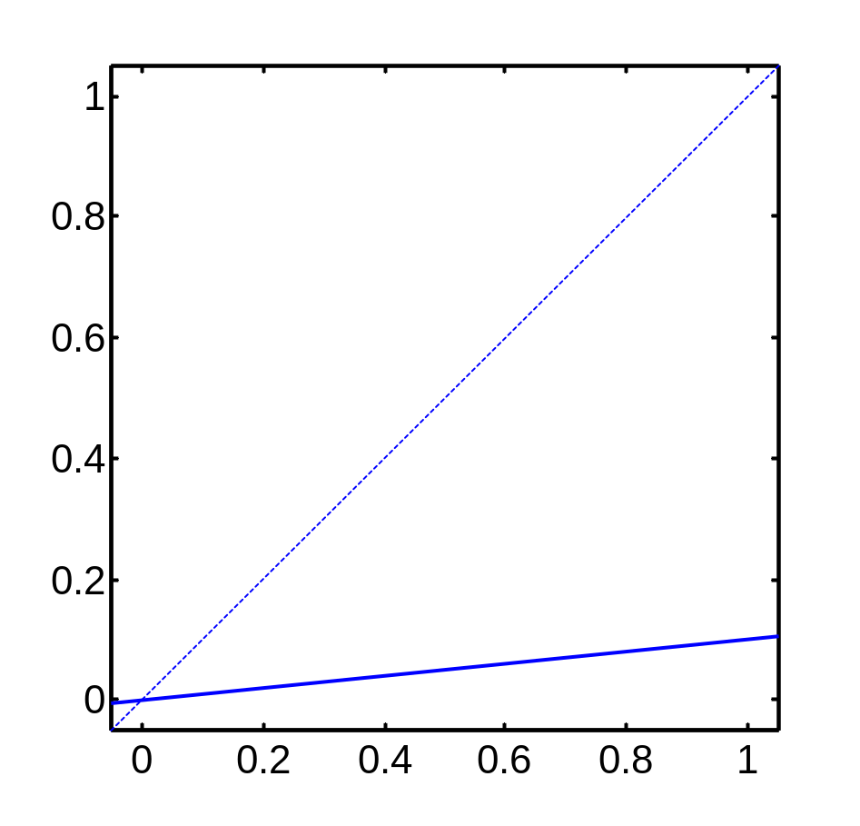
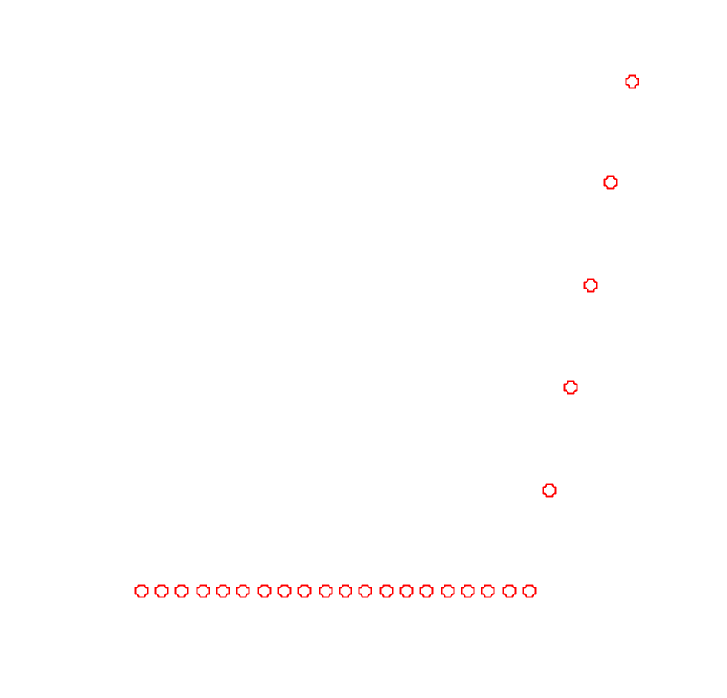
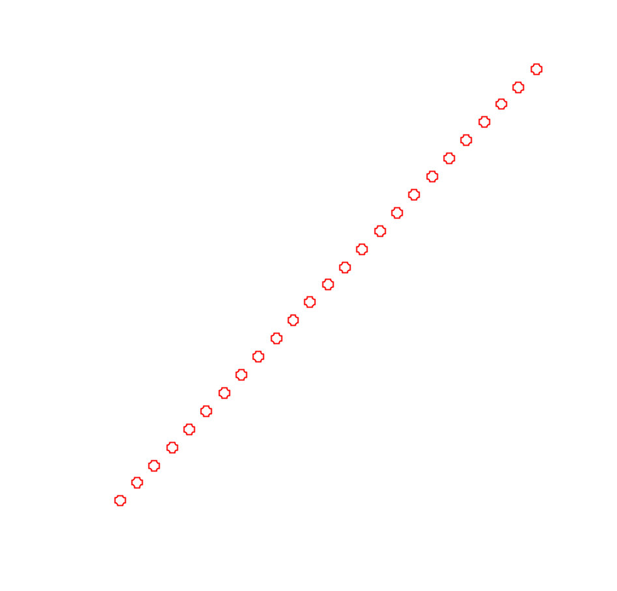
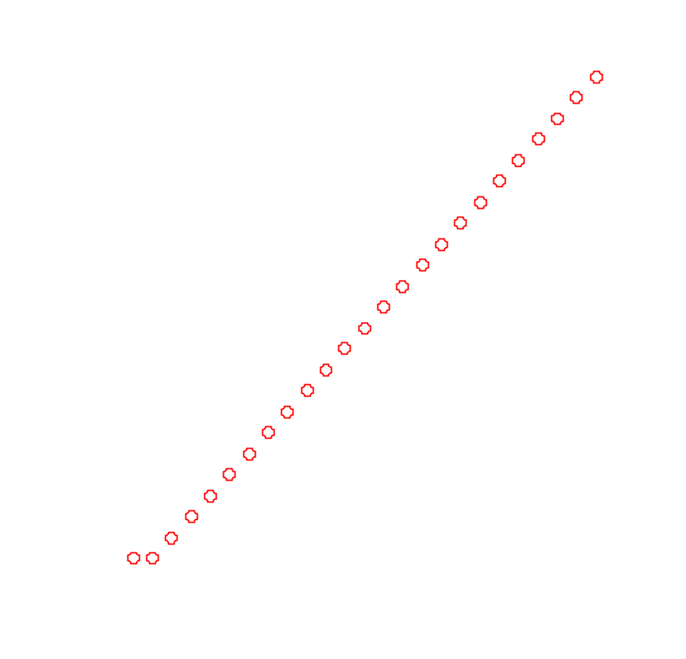
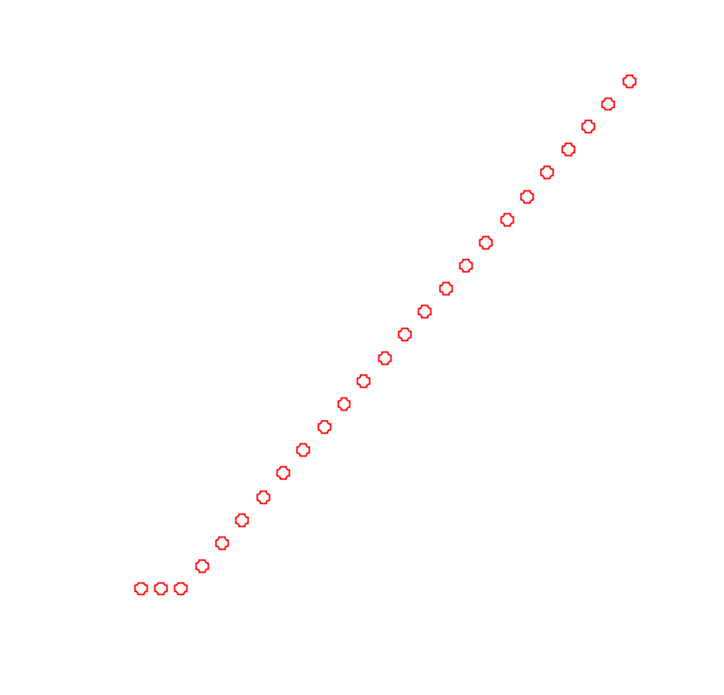

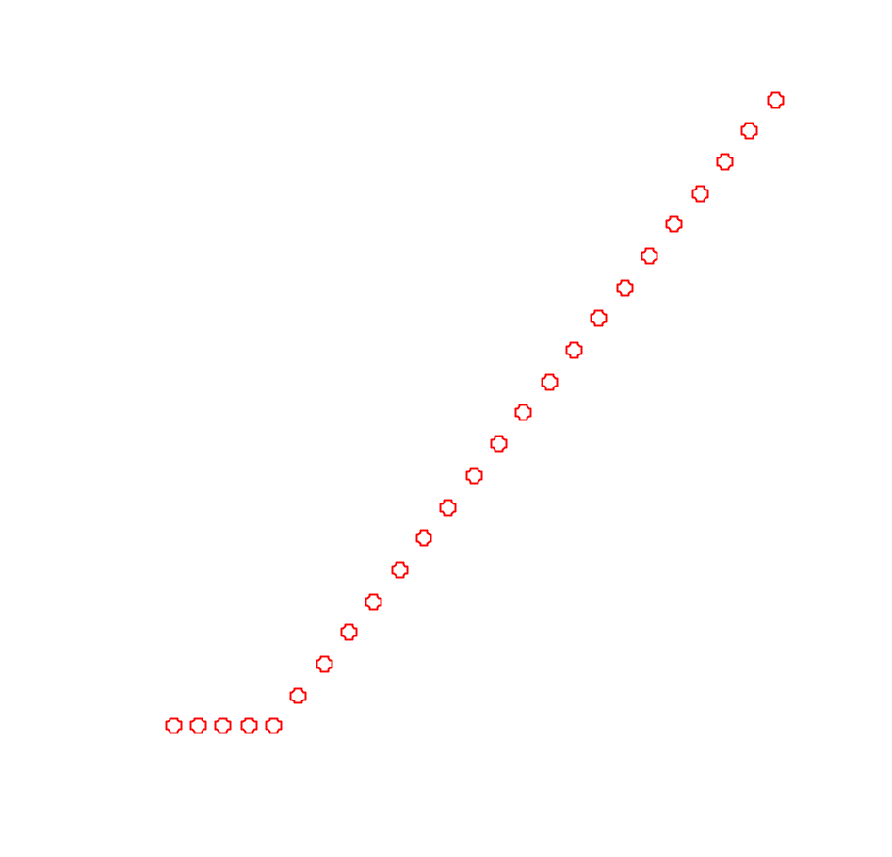


















Adaptiveness of
Benjamini & Hochberg FDR
Ordered p-values p_{(i)}
P-value threshold when no signal:
α/V
P-value threshold
when all
signal:
α
Fractional index i/V

Slide 44


Real Data: FDR Example
Threshold
  Indep/PosDep
  u = 3.83
  Arb Cov
  u = 13.15
Result
  3,073 voxels above
  Indep/PosDep u
  <0.0001 minimum
  FDR-corrected
  p-value
FDR Threshold = 3.83
3,073 voxels
FWER Perm. Thresh. = 9.87
7 voxels

Slide 45
FDR Changes
Before SPM8
  Only voxel-wise FDR
SPM8
  Cluster-wise FDR
  Peak-wise FDR
  Voxel-wise available: edit spm_defaults.m to read
  defaults.stats.topoFDR = 0;
Item Recognition data
Cluster-forming threshold P=0.001
Cluster-wise FDR: 40 voxel cluster, P_{FDR} 0.07
Peak-wise FDR: t=4.84, P_{FDR} 0.836
Cluster-forming threshold P=0.01
Cluster-wise FDR: 1250 - 4380 voxel clusters, P_{FDR} <0.001
Cluster-wise FDR: 80 voxel cluster, P_{FDR} 0.516
Peak-wise FDR: t=4.84, P_{FDR} 0.027

Slide 46
Benjamini & Hochberg Procedure Details
Standard Result
  Positive Regression Dependency on Subsets
    P(X₁≥c₁, X₂≥c₂, ..., X_{k}≥c_{k} | X_{i}=x_{i}) is non-decreasing in x_{i}
    Only required of null x_{i}’s
      Positive correlation between null voxels
      Positive correlation between null and signal voxels
    Special cases include
      Independence
      Multivariate Normal with all positive correlations
Arbitrary covariance structure
  Replace q by q/c(V),
  c(V) = Σ_{i=1,...,V} 1/i ≈ log(V)+0.5772
  Much more stringent
Benjamini &
Yekutieli (2001).
Ann. Stat.
29:1165-1188

Slide 47
Benjamini & Hochberg:
Key Properties
FDR is controlled
E(rFDR) ≤ q m₀/V
  Conservative, if large fraction of nulls false
Adaptive
  Threshold depends on amount of signal
    More signal, More small p-values,
    More p_{(i)} less than i/V × q/c(V)

Slide 48


Controlling FDR:
Varying Signal Extent
p = z =
Signal Intensity 3.0
Signal Extent 1.0
Noise Smoothness 3.0
1

Slide 49


Controlling FDR:
Varying Signal Extent
p = z =
Signal Intensity 3.0
Signal Extent 2.0
Noise Smoothness 3.0
2

Slide 50


Controlling FDR:
Varying Signal Extent
p = z =
Signal Intensity 3.0
Signal Extent 3.0
Noise Smoothness 3.0
3

Slide 51


Controlling FDR:
Varying Signal Extent
p = 0.000252 z = 3.48
Signal Intensity 3.0
Signal Extent 5.0
Noise Smoothness 3.0
4

Slide 52


Controlling FDR:
Varying Signal Extent
p = 0.001628 z = 2.94
Signal Intensity 3.0
Signal Extent 9.5
Noise Smoothness 3.0
5

Slide 53


Controlling FDR:
Varying Signal Extent
p = 0.007157 z = 2.45
Signal Intensity 3.0
Signal Extent 16.5
Noise Smoothness 3.0
6

Slide 54


Controlling FDR:
Varying Signal Extent
p = 0.019274 z = 2.07
Signal Intensity 3.0
Signal Extent 25.0
Noise Smoothness 3.0
7

Slide 55
Controlling FDR:
Benjamini & Hochberg
Illustrating BH under dependence
  Extreme example of positive dependence
8 voxel image
1
p_{(i)}
p-value
32 voxel image
(interpolated from 8 voxel image)
i/V × q/c(V)
0
0
i/V
1

Slide 56
Conclusions
Must account for multiplicity
  Otherwise have a fishing expedition
FWER
  Very specific, not very sensitive
FDR
  Voxel-wise: Less specific, more sensitive
  Cluster-, Peak-wise: Similar to FWER

Slide 57
References
Most of this talk covered in these papers
TE Nichols & S Hayasaka, Controlling the Familywise Error Rate in Functional Neuroimaging: A Comparative Review. Statistical Methods in Medical Research, 12(5): 419-446, 2003.
TE Nichols & AP Holmes, Nonparametric Permutation Tests for Functional Neuroimaging: A Primer with Examples. Human Brain Mapping, 15:1-25, 2001.
CR Genovese, N Lazar & TE Nichols, Thresholding of Statistical Maps in Functional Neuroimaging Using the False Discovery Rate. NeuroImage, 15:870-878, 2002.

